Slide 1


Python
Programming

Slide 2
Agenda
* Line Comment
* Operation
* Number
* interactive mode
* String
* List
* Loop

Slide 3
An Informal Introduction to Python
Line Comment examples:
# this is the first comment
spam = 1 # and this is the second comment
# ... and now a third!
text = "# This is not a comment because it's inside quotes."

Slide 4

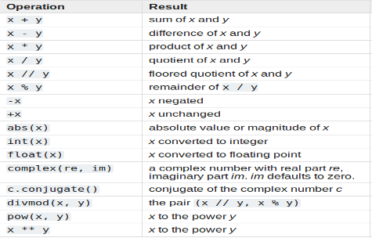
Using Python as a Calculator
#Operation

Slide 5
Using Python as a Calculator
#Numbers
>>> 2 + 2
4
>>> 50 - 5*6
20
>>> (50 - 5*6) / 4
5.0
>>> 8 / 5 # division always returns a floating point number
1.6

Slide 6
Using Python as a Calculator
#Division
>>> 17 / 3 # classic division returns a float
5.666666666666667
>>>
>>> 17 // 3 # floor division discards the fractional part
5
>>> 17 % 3 # the % operator returns the remainder of the division
2
>>> 5 * 3 + 2 # result * divisor + remainder
17

Slide 7
Using Python as a Calculator
#calculate powers
>>> 5 ** 2 # 5 squared
25
>>> 2 ** 7 # 2 to the power of 7
128
#equal sign (=)
>>> width = 20
>>> height = 5 * 9
>>> width * height
900

Slide 8
Using Python as a Calculator
#If a variable is not “defined”
>>> n # try to access an undefined variable
Traceback (most recent call last):
File "<stdin>", line 1, in <module>
NameError: name 'n' is not defined

Slide 9
Using Python as a Calculator
#interactive mode
The last printed expression is assigned to the variable ( _ ).
>>> tax = 12.5 / 100
>>> price = 100.50
>>> price * tax
12.5625
>>> price + _
113.0625
>>> round(_, 2)
113.06

Slide 10
Using Python as a String
#Strings
>>> 'spam eggs' # single quotes
'spam eggs'
>>> 'doesn\'t' # use \' to escape the single quote...
"doesn't"
>>> "doesn't" # ...or use double quotes instead
"doesn't"

Slide 11
Using Python as a String
#Strings
>>> '"Isn\'t," she said.'
'"Isn\'t," she said.'
>>> print('"Isn\'t," she said.')
"Isn't," she said.
>>> s = 'First line.\nSecond line.' # \n means newline
'First line.\nSecond line.'
>>> s # without print(), \n is included in the output
>>> print(s) # with print(), \n produces a new line
First line.
Second line.

Slide 12
Using Python as a String
#Strings
>>> print('C:\some\name') # here \n means newline!
C:\some
ame
>>> print(r'C:\some\name') # note the r before the quote
C:\some\name
print("""\
Usage: thingy [OPTIONS]
-h Display this usage message
-H hostname Hostname to connect to
""")

Slide 13
Using Python as a String
#Strings
can be concatenated (glued together) with the + operator, and repeated with *
>>> # 3 times 'un', followed by 'ium'
>>> 3 * 'un' + 'ium'
'unununium'
>>> 'Py' 'thon'
'Python'

Slide 14
Using Python as a String
#Strings
This only works with two literals though, not with variables or expressions:
>>> prefix = 'Py'
>>> prefix 'thon' # can't concatenate a variable and a string literal
...
SyntaxError: invalid syntax
>>> ('un' * 3) 'ium'
...
SyntaxError: invalid syntax

Slide 15
Using Python as a String
#Strings index
>>> word = 'Python'
>>> word[0] # character in position 0
'P'
>>> word[5] # character in position 5
'n'
>>> word[-1] # last character
'n'
>>> word[-2] # second-last character
'o'
>>> word[-6]
'P'

Slide 16
Using Python as a String
#Strings index
>>> word = 'Python'
>>> word[0] # character in position 0
'P'
>>> word[5] # character in position 5
'n'
>>> word[-1] # last character
'n'
>>> word[-2] # second-last character
'o'
>>> s = 'supercalifragilisticexpialidocious'
>>> len(s)
34

Slide 17
Python Lists
#List
>>> squares = [1, 4, 9, 16, 25]
>>> squares
[1, 4, 9, 16, 25]
>>> squares[0] # indexing returns the item
1
>>> squares[-1]
25
>>> squares[-3:] # slicing returns a new list
[9, 16, 25]

Slide 18
Python Lists
#List operations
>>> squares = [1, 4, 9, 16, 25]
>>> squares[:]
[1, 4, 9, 16, 25]
Lists also support operations like concatenation:
>>> squares + [36, 49, 64, 81, 100]
[1, 4, 9, 16, 25, 36, 49, 64, 81, 100]
>>> cubes = [1, 8, 27, 65, 125] # something's wrong here
>>> 4 ** 3 # the cube of 4 is 64, not 65!
64
>>> cubes[3] = 64 # replace the wrong value
>>> cubes
[1, 8, 27, 64, 125]

Slide 19
Python Lists
#List operations
You can also add new items at the end of the list, by using the append()
>>> cubes = [1, 8, 27, 64, 125]
>>> cubes.append(216) # add the cube of 6
>>> cubes.append(7 ** 3) # and the cube of 7
>>> cubes
[1, 8, 27, 64, 125, 216, 343]

Slide 20
Python Lists
#List operations
>>> letters = ['a', 'b', 'c', 'd', 'e', 'f', 'g']
>>> letters
['a', 'b', 'c', 'd', 'e', 'f', 'g']
>>> # replace some values
>>> letters[2:5] = ['C', 'D', 'E']
>>> letters
['a', 'b', 'C', 'D', 'E', 'f', 'g']

Slide 21
Python Lists
#List operations
>>> letters
['a', 'b', 'C', 'D', 'E', 'f', 'g']
# now remove them
>>> letters[2:5] = []
>>> letters
['a', 'b', 'f', 'g']
>>> # clear the list by replacing all the elements with an empty list
>>> letters[:] = []
>>> letters
[]

Slide 22
Python Lists
#List operations
It is possible to nest lists (create lists containing other lists), for example:
>>> a = ['a', 'b', 'c']
>>> n = [1, 2, 3]
>>> x = [a, n]
>>> x
[['a', 'b', 'c'], [1, 2, 3]]
>>> x[0]
['a', 'b', 'c']
>>> x[0][1]
'b'

Slide 23
Python Lists
#List operations
* list.append(x)
* list.extend(L)
* list.insert(i, x)
* list.index(start, end)
* list.count(x)
* list.reverse()

Slide 24
Python Lists
#List operations
>>> fruits = ['orange', 'apple', 'pear', 'banana', 'kiwi', 'apple', 'banana']
>>> fruits.count('apple')
2
>>> fruits.count('tangerine')
0
>>> fruits.index('banana')
3
>>> fruits.index('banana', 4) # Find next banana starting a position 4
6

Slide 25
Python Lists
#List operations
>>> fruits.reverse()
>>> fruits
['banana', 'apple', 'kiwi', 'banana', 'pear', 'apple', 'orange']
>>> fruits.append('grape')
>>> fruits
['banana', 'apple', 'kiwi', 'banana', 'pear', 'apple', 'orange', 'grape']
>>> fruits.sort()
>>> fruits
['apple', 'apple', 'banana', 'banana', 'grape', 'kiwi', 'orange', 'pear']
>>> fruits.pop()
'pear'

Slide 26
Python Lists
#List methods
sort() arranges the elements of the list from low to high:
t = ['d', 'c', 'e', 'b', 'a']
t.sort()
print(t)
extend() takes a list as an argument and appends all of the elements:
t1 = ['a', 'b', 'c']
t2 = ['d', 'e']
t1.extend(t2)
print(t1)

Slide 27
Python Lists
#Deleting List elements
There are several ways to delete elements from a list. If you know the index of the element you want, you can use pop():
t = ['a', 'b', 'c']
x = t.pop(1)
print(t)
If you don't need the removed value, you can use the del operator:
t = ['a', 'b', 'c']
del t[1]
print(t)

Slide 28
Python Lists
#Deleting List elements
How remove more than one element, you can use del with a slice index:
t = ['a', 'b', 'c', 'd', 'e', 'f']

Slide 29
Python Lists
#Lists and functions
There are a number of built-in functions that can be used on lists that allow you to quickly look through a list without writing your own loops:
len(nums)
max(nums)
min(nums)
sum(nums)
Example:
Nums = [3, 41, 12, 9, 74, 15]
print(len(nums))

Slide 30
Exercise 1
#We could rewrite program that computed the average of a list of numbers entered by the user using a list.
total = 0
count = 0
while ( True ) :
inp = input('Enter a number: ')
if inp == 'done' : break
value = float(inp)
total = total + value
count = count + 1
average = total / count
print ('Average:', average)

Slide 31
Python Lists
#Lists and strings
A string is a sequence of characters and a list is a sequence of values, but a list of characters is not the same as a string. To convert from a string to a list of characters, you can use list:
s = 'spam'
t = list(s)
print (t)
The list function breaks a string into individual letters.

Slide 32
Python Lists
#Lists and strings
If you want to break a string into words, you can use the split method:
s = 'list is the name of a built-in function'
t = s.split()
print (t)
The split() break a string into words.

Slide 33
Python Lists
#Lists and strings
You can call split with an optional argument called a delimiter specifies which characters to use as word boundaries.
s = 'spam-spam-spam'
delimiter = '-'
print(s.split(delimiter))

Slide 34
Python Lists
#Lists and strings
join is the inverse of split. It takes a list of strings and concatenates the elements.
t = ['join', 'is', 'the', 'inverse' , 'of','split']
delimiter = ' '
print(delimiter.join(t))

Slide 35
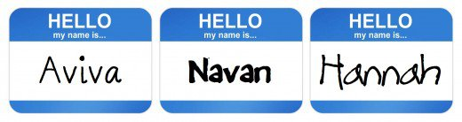
Exercise 1
#String Lists
Ask the user for a string and print out whether this string is a palindrome or not. (A palindrome is a string that reads the same forwards and backwards.)

Slide 36
Exercise 1
#String Lists(solution)
wrd=input("Please enter a word \n")
wrd=str(wrd)
rvs=wrd[::-1]
print(rvs)
if wrd == rvs:
print("This word is a palindrome")
else:
print("This word is not a palindrome")

Slide 37
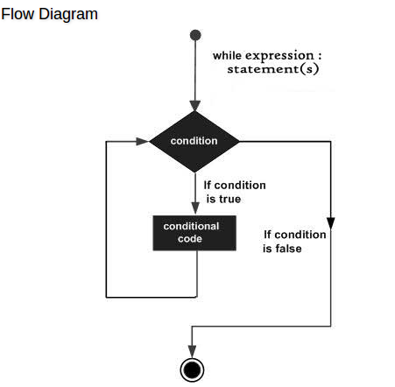
Python while Loop
#A while loop statement in Python programming language repeatedly executes a target statement as long as a given condition is true.

Slide 38
Python while Loop
#Here, statement(s) may be a single statement or a block of statements. The condition may be any expression, and true is any non-zero value. The loop iterates while the condition is true.
while expression:
statement(s)

Slide 39
Python while Loop
count = 0
while (count < 9):
print 'The count is:', count
count = count + 1
print "Good bye!"

Slide 40
Python while Loop
#while loop with else
counter = 0
while counter < 3:
print("Inside loop")
counter = counter + 1
else:
print("Inside else")

Slide 41
Python while Loop
#while Loop
# To take input from the user,
n = int(input("Enter n: "))
# initialize sum and counter
sum = 0
i = 1
while i <= n:
sum = sum + i
i = i+1 # update counter
# print the sum
print("The sum is", sum)

Slide 42

Exercise 2
#Guessing Number Game
Ask the user to guess the number, then tell them whether they guessed too low, too high, or exactly right.

Slide 43
Exercise 2 (solution)

Slide 44
Exercise 3

Slide 45
Python while Loop
#while Loop
A Fibonacci sequence is the integer sequence
# change this value for a different result
nterms = 10
#nterms = int(input("How many terms? "))
# first two terms
n1 = 0
n2 = 1
count = 2
n2 = nth
count += 1

Slide 46
Python while Loop
#while Loop
# check if the number of terms is valid
if nterms <= 0:
print("Please enter a positive integer")
elif nterms == 1:
print("Fibonacci sequence upto",nterms,":")
print(n1)

Slide 47
Python while Loop
#while Loop
else:
print("Fibonacci sequence upto",nterms,":")
print(n1,",",n2,end=', ')
while count < nterms:
nth = n1 + n2
print(nth,end=' , ')
# update values
n1 = n2
n2 = nth
count += 1

Slide 48
Python while Loop
#while Loop
>>> # Fibonacci series:
... # the sum of two elements defines the next
... a, b = 0, 1
>>> while b < 10:
... print(b)
... a, b = b, a+b
...
1
1
2
3
5
8

